Slide 1
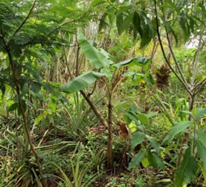
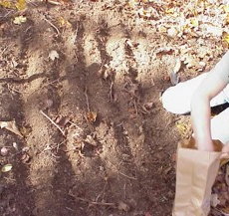
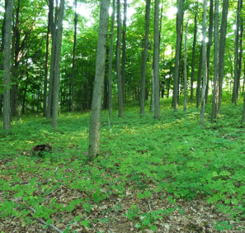
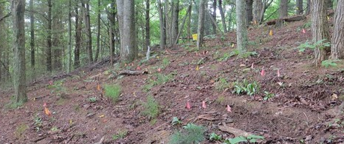
Module 7: Forest Farming and Soil Health
Notes:
Photos, clockwise from left: Multi-story forest garden, Pacific Island, Matthew Cocking, NRCS. Planting wild-simulated bloodroot, Forest Farming Community flickr page, wild simulated ginseng by Catherine Bukowski, Forest Farming Community hillside forest farming by Katie Trozzo, Forest Farming Community flickr
https://www.flickr.com/people/forestfarming/

Slide 2
Module 7: Overview
Agroforestry Review
Forest Farming -
  Defined
  Examples
  Impacts on Soil Health
Notes:
In this module, we will discuss:
What is agroforestry
How agroforestry is defined by USDA and other organizations
What is forest farming and how it impacts soil health

Slide 3
Agroforestry is…
“…a management system that combines agriculture and trees to address conservation needs and build more profitable and weather-resilient farms, ranches and communities. Agroforestry practices provide opportunities to integrate productivity and profitability with environmental stewardship resulting in healthy and sustainable agricultural systems that can be passed on to future generations.” National Agroforestry Center
“…an intensive land management system that optimizes the benefits from the biological interactions created when trees and/or shrubs are deliberately combined with crops and/or livestock…Within each agroforestry practice, there is a continuum of options available to landowners depending o­n their own goals…” Association for Temperate Agroforestry
“…Diversified farming and ranching systems that include trees and other perennial shrubs and crops.” “…an umbrella term encompassing a variety of polycultural farming practices that intentionally integrate perennial trees and shrubs with other crops and/ or livestock.” Agroforestry Coalition
Notes:
Lets quickly look at a few definitions from respected groups in the world of agroforestry in the U.S. This first definition is from the National Agroforestry Center.

Slide 4
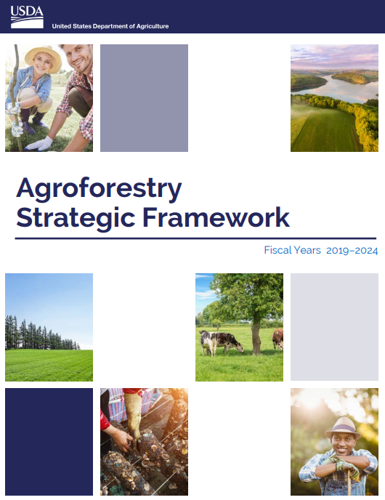
Agroforestry Is…
The intentional integration of trees or shrubs with crop or animal production to create environmental, economic, and social benefits (USDA Agroforestry Strategic Framework, Fiscal Years 2019-2024).
Notes:
Finally, USDA defines agroforestry here in the Strategic Framework. This is the definition that NRCS can hang its hat on.
Other Defs – not included in presentation
Agroforestry is a management system that combines agriculture and trees to address conservation needs and build more profitable and weather-resilient farms, ranches and communities (National Agroforestry Center https://www.fs.usda.gov/nac). Working Trees for people and agriculture
NCA5 definition - Collective name for land-use systems and technologies where woody perennials (trees, shrubs, palms, bamboos, etc.) are deliberately used on the same land-management units as agricultural crops and/or animals in some form of spatial arrangement or temporal sequence. In agroforestry systems, there are both ecological and economic interactions between the different components. Agroforestry can also be defined as a dynamic, ecologically based, natural resource management system that, through the integration of trees on farms and in the agricultural landscape, diversifies and sustains production to increase social, economic, and environmental benefits for land users.7

Slide 5

Agroforestry and Context
Agroforestry as Defined by Academia, Tribes, Partners, and NGOs.
Understand Agroforestry within a broader sense.
Plan Agroforestry within the context of NRCS Practices and Program Policies
National NRCS Agroforestry Conservation Practice Standards
State NRCS Agroforestry Conservation Practice Standards
NRCS Program Policy Related to Agroforestry Practices
Notes:
Outside of NRCS, agroforestry and agroforestry practices can mean different things to different groups and also varies regionally. This diagram helps put our national and state standards in perspective, within the larger context of agroforestry as a whole. As discipline leads, technical specialists, and planners, we need to recognize this to better understand what our customers are asking for.

Slide 6
Agroforestry – Working Trees for People
Enhanced Production
Cultural and Societal
Food Security
Notes:
We recognize that agroforestry practices can be used to address a resource concerns within each NRCS Resource Category. However, another important Benefit – Agroforestry is Working Tree for People.
Agroforestry practices can be designed to enhance adjacent/associated crop production through functions of protection, altering microclimates, and pollinator habitat improvement.
Agroforestry practices can provide cultural and societal benefits, from traditional cultural associations and interdependence to providing improved basic conditions for farmers to work in.
Agroforestry practices provide opportunities for farmers and landowners to provide more sustainable food sources for themselves and their families.
Additional/long overview:
Finally, while NRCS planners must focus on Natural Resource Concerns, we must also consider the Client’s Production Goals and Economic Needs in all planning activities, as described in Title 180, GM Part 409.1 B: “…The objective in conservation planning is to help each client attain sustainable use and sound management of soil, water, air, plant, animal, and energy resources, based on related human considerations. The purpose is to prevent the degradation of resources and to ensure their sustained use and productivity, while considering the client’s economic and social needs. Conservation planning assistance is based on ecological, economic, and social considerations relative to the resources.”

Slide 7
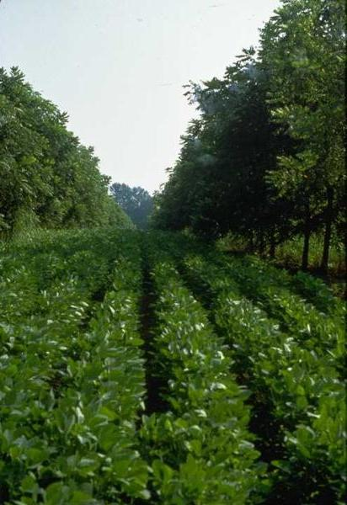
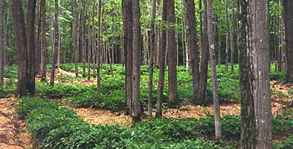
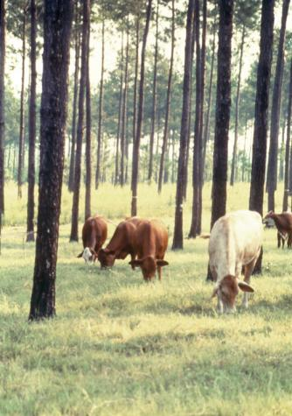
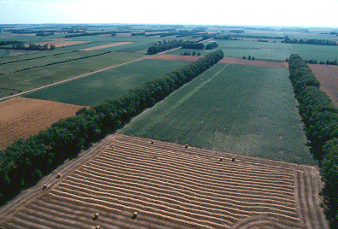
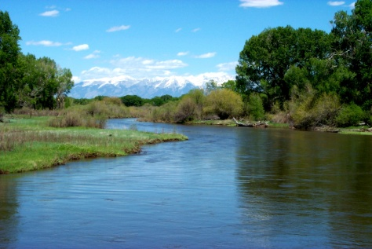
Agroforestry Practices
311 – Alley Cropping
379 – Forest Farming
380 – Windbreak/Shelterbelt Establishment and Renovation
381 – Silvopasture
391 – Riparian Forest Buffers
Notes:
NRCS recognizes five agroforestry practices. ….But before we start talking about forest farming, lets step back and lay some groundwork by building an understanding of agroforestry.

Slide 8
Other Practices Used to Implement Agroforestry
338 – Prescribed Burning
612 – Tree and Shrub Establishment
314 – Brush Management
666 – Forest Stand Improvement
643 – Restoration of Rare or Declining Plant Communities
420 – Wildlife Habitat Planting
825 – Culturally Significant Plantings for Soil Health
Notes:
Forest Farming can be implemented using a variety of practices. While it is desirable

Slide 9
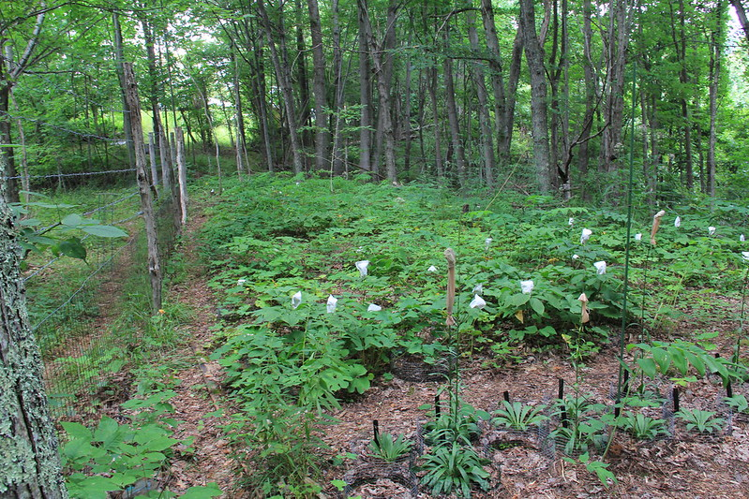

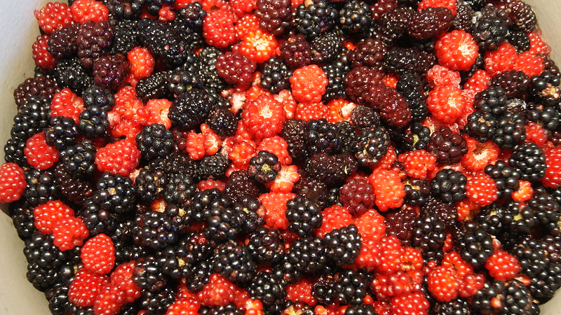
Forest Farming

Slide 10
Forest Farming Defined
Managing or establishing stands of trees or shrubs in coordination with the management and/or cultivation of understory plants or nontimber forest products. – NRCS 379 CPS, 2022
The combination of crops (plants, animals, fungi) and trees in forest-inspired agricultural systems that benefit human communities through greater connection to the landscape, improved stewardship of resources, and enhanced economic opportunities. – Mudge and Gabriel, 2014
Notes:
NRCS 379 CPS definition: There are several key points to recognize in this definition.
Manage or establish – Manage is usually associated with manipulating the existing vegetation, including thinning trees and removing invasive spp. Establishing usually refers to planting trees or shrubs to establish a new forest farm or multi layered food forest. Some states do employ payment scenarios for establishment of understory veg.
Management or cultivation represents a diverse mix of activities associated with growing the crop. Intensity level ranges from minimalistic “gathering or stewarding” activities to more intensive such as tilling and planting.
Crops in a forest farming system include understory plants as well as non-timber forest products (which includes fruits, nuts, sap, flowers, branches, bark, etc.).
Another definition is shared here to represent an outside-NRCS perspective. Recall the nested-circles diagram in a previous slide. This represents what our clients understand forest farming to be. It is our job to consider their objectives as we work to identify resource concerns that may be addressed relative to our NRCS definition.
Farming the Woods. Ken Mudge and Steve Gabriel. 2014. Chelsea Green Publishing

Slide 11

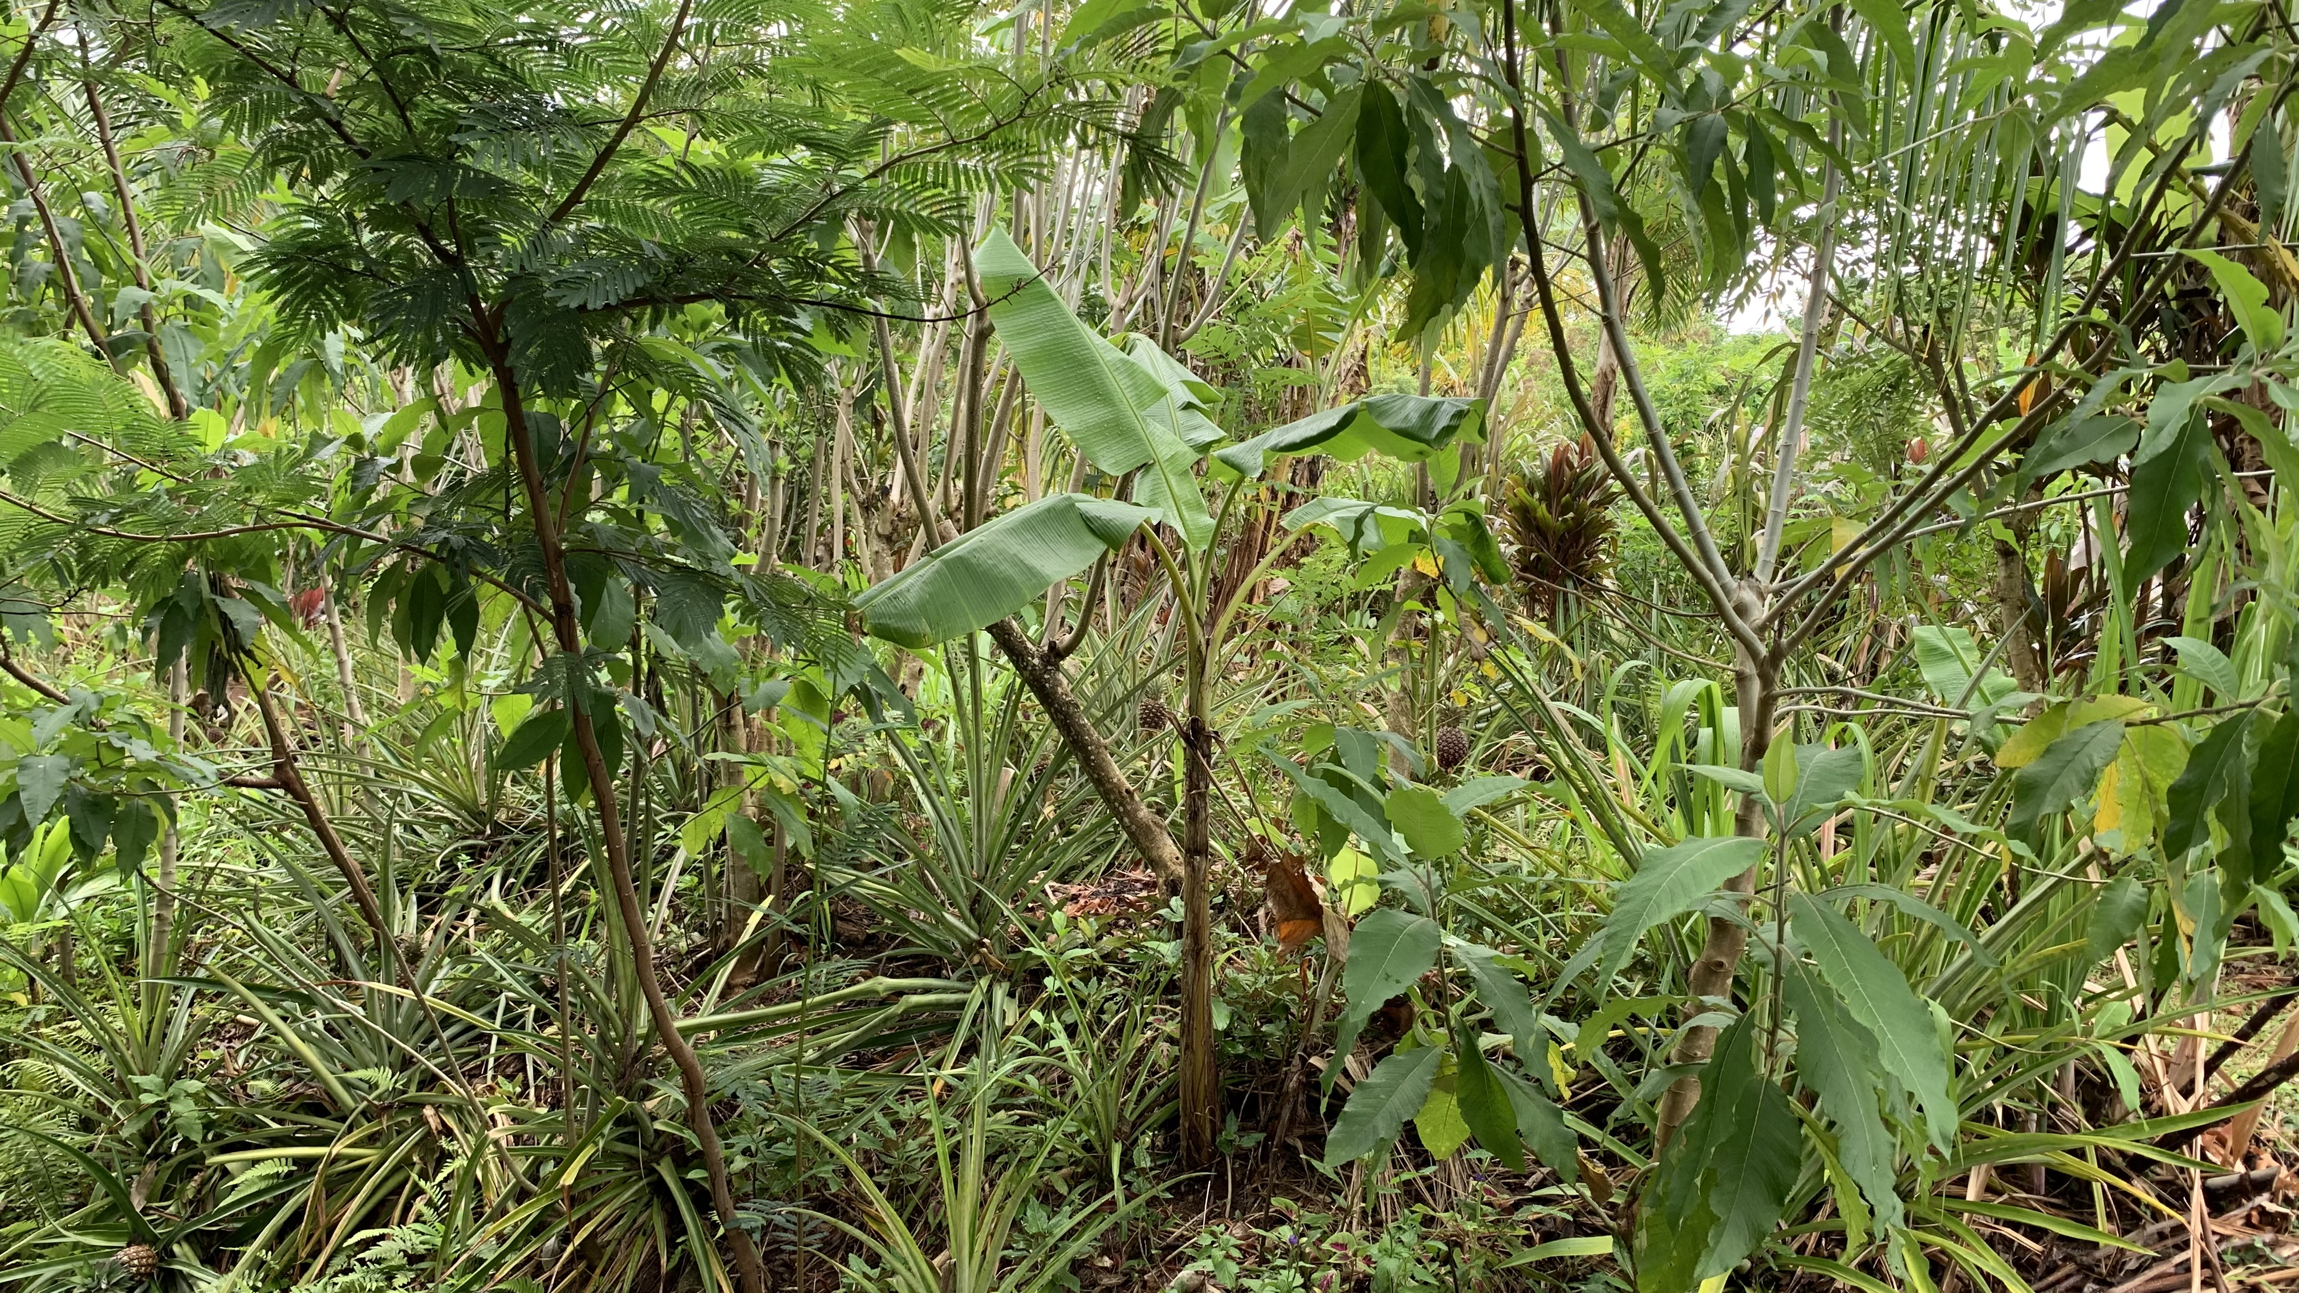
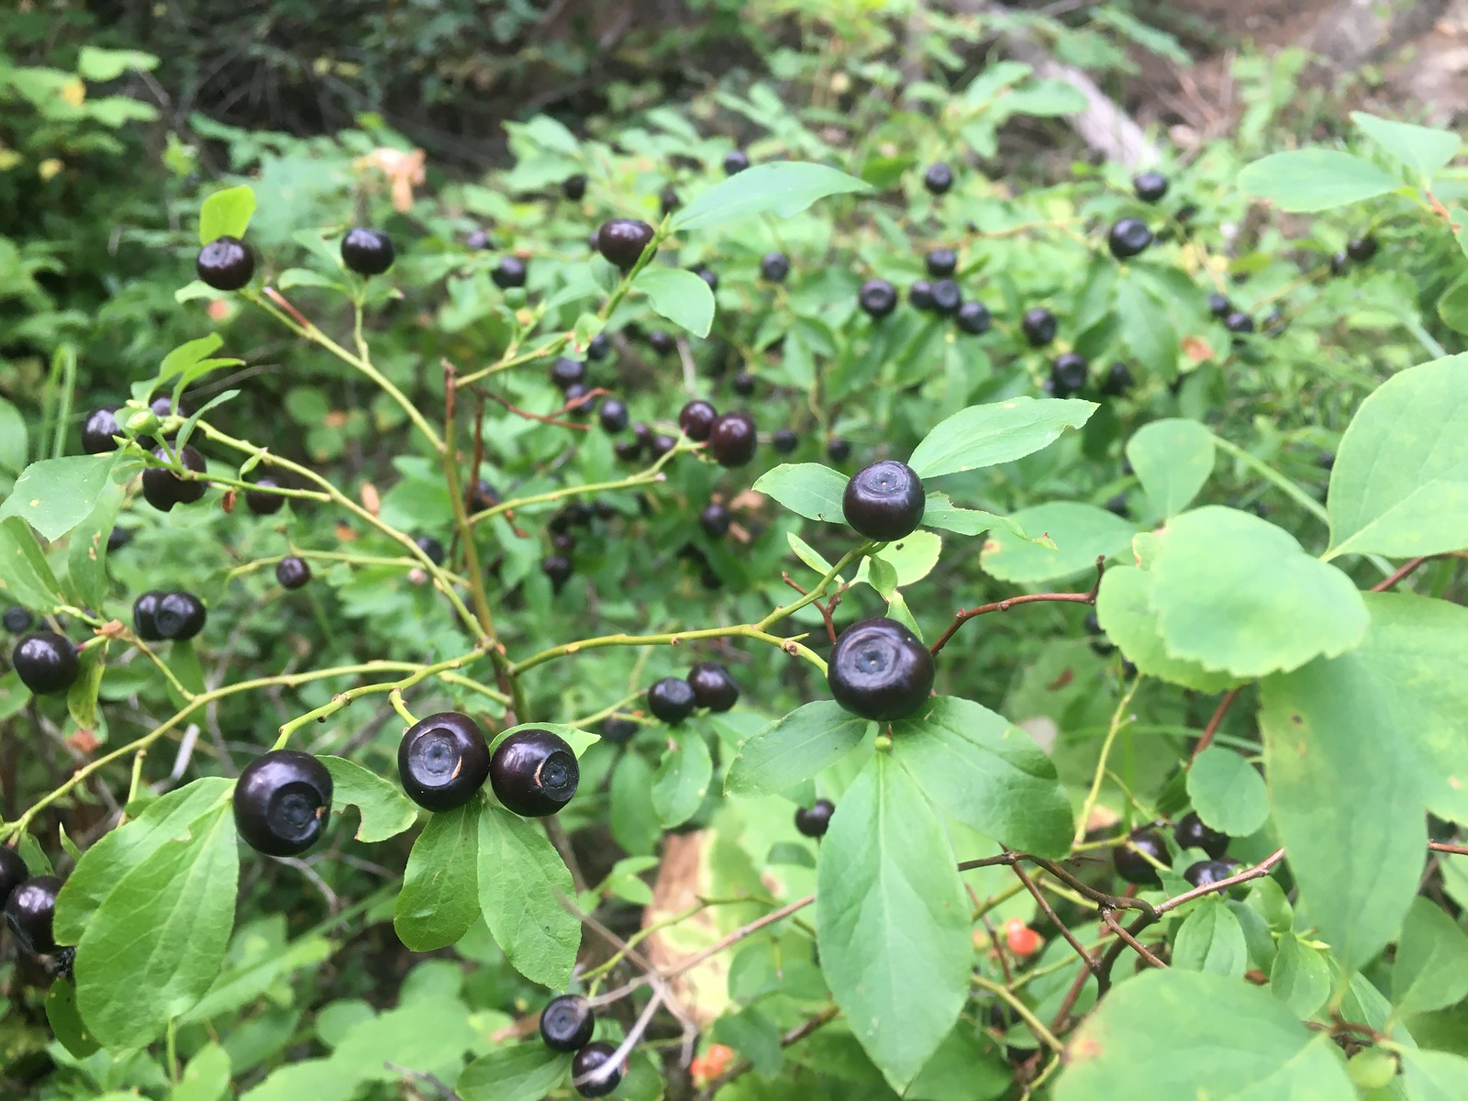
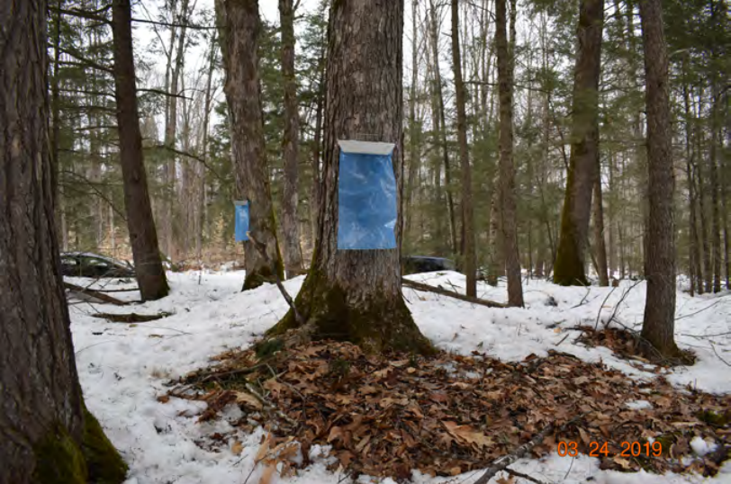
Notes:
Forest farming can look differently depending on type of plants that are managed for production, the level of management intensity, and regional soil and biological variations.

Slide 12
Forest Farming – Historic Examples
Culturally relevant, forest food systems supported indigenous communities (Smith, 2009) and soil health (Sandor and Homburg, 2017) for a millennia.
Widespread evidence of “niche building” where forest edges were maintained with early successional food/medicinal plants, and fruit bearing trees (Smith, 2009).
Important source of food for some enslaved peoples (Bowes, 2011).
Notes:
Forest farming was a key source of food for many communities in the past, including indigenous and enslaved peoples.

Slide 13
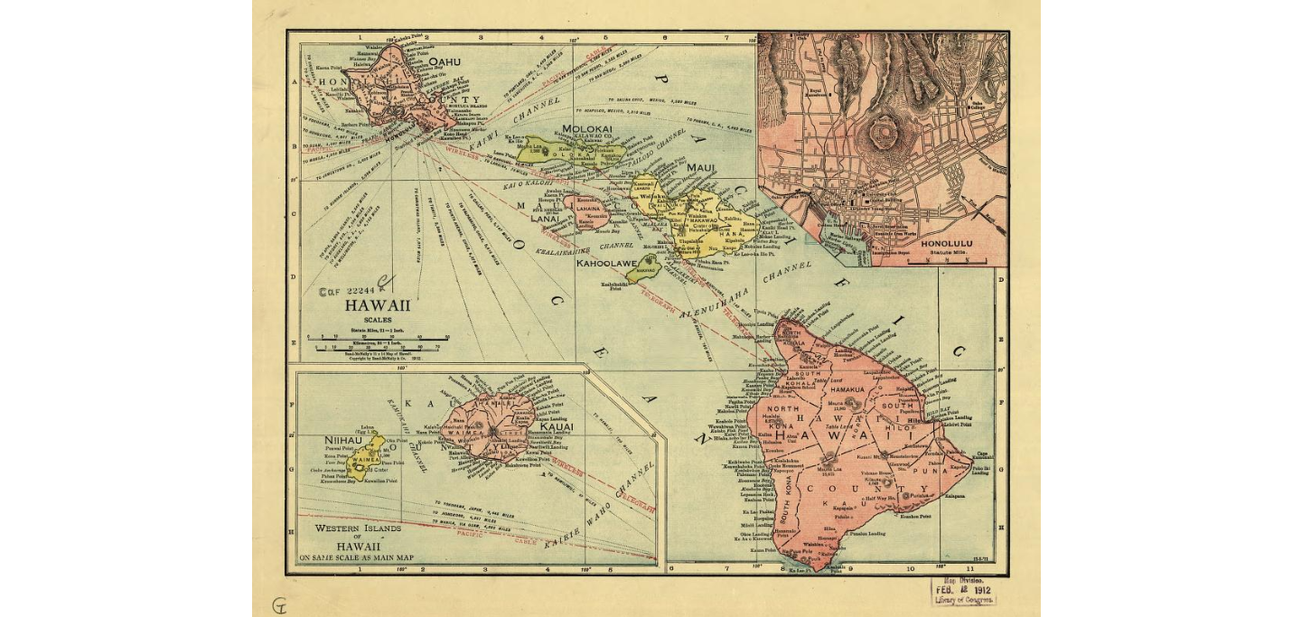
Forest Farming – Hawai’i Precolonial Contact
Islands supported over 800,000 Hawaiians.
Agricultural systems produced >1.02 million metric tons of food per year.
28% came from forest farming.
Mix of annual, perennial, shrub, and tree crops.
(Kurashima et al., 2019)
Photo: Library of Congress
Notes:
The Hawai'an islands is an excellent example of how forest farming was a key source of food for indigenous communities prior to colonial contact.
It is estimated that forest farming produced over one million metric tons of food!
Many perennial tree crops were cultivated on colluvial slope of valleys using terracing. Crops such as ti (Cordyline fruticosa), the bitter yam (Dioscorea bulbifera), bananas (Musa sp.), and breadfruit trees (Artocarpus altilis) were cultivated in forest farming systems.

Slide 14
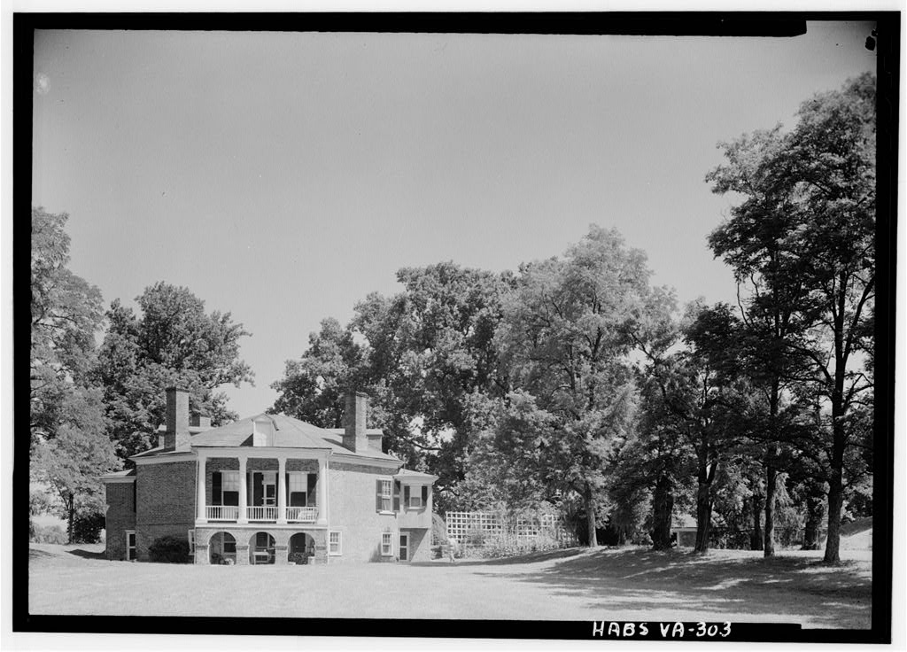
Forest Farming – Jefferson’s Poplar Forest Plantation, VA
Macrobotanical research suggests that slaves owned by Thomas Jefferson supplemented their food by cultivating and foraging forest edges (Bowes, 2011).
Forest foods included wild grape, elderberry, raspberry, acorn, and hazelnut.
Photo: Library of Congress
Notes:
There is evidence that enslaved people used forest farming to supplement their diets and provide important nutritional value.

Slide 15
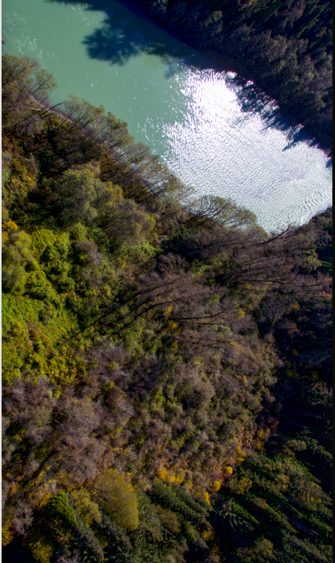
Forest Farming in the Pacific Northwest
An ancestral Ts’msyen village site in northwestern British Columbia still harbors a distinct mix of species beneficial to humans at least 150 years after it was planted.
From -https://www.science.org/content/article/pacific-northwest-s-forest-gardens-were-deliberately-planted-indigenous-people
Story – Andrew Curry. Photo – Storm Carroll
Notes:
As mentioned earlier in the presentation, recognize that North American tribes have been practicing forest farming for a long time as demonstrated in this example identified in British Columbia. To summarize, researchers found that some of the plants in this location were not the same as surrounding forest and included spp that are important to indigenous people. These conditions remain after 150 years of being “unmanaged”. This contrasted with adjacent sites that were logged (disturbed) that did not regenerate into similar spp as found on the planted site.
Pronunciation: Tsim-she-yan

Slide 16
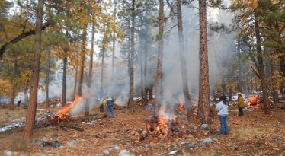
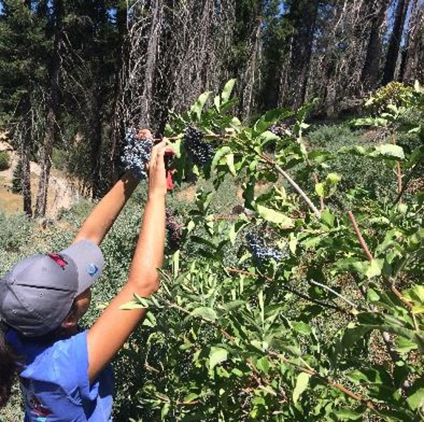
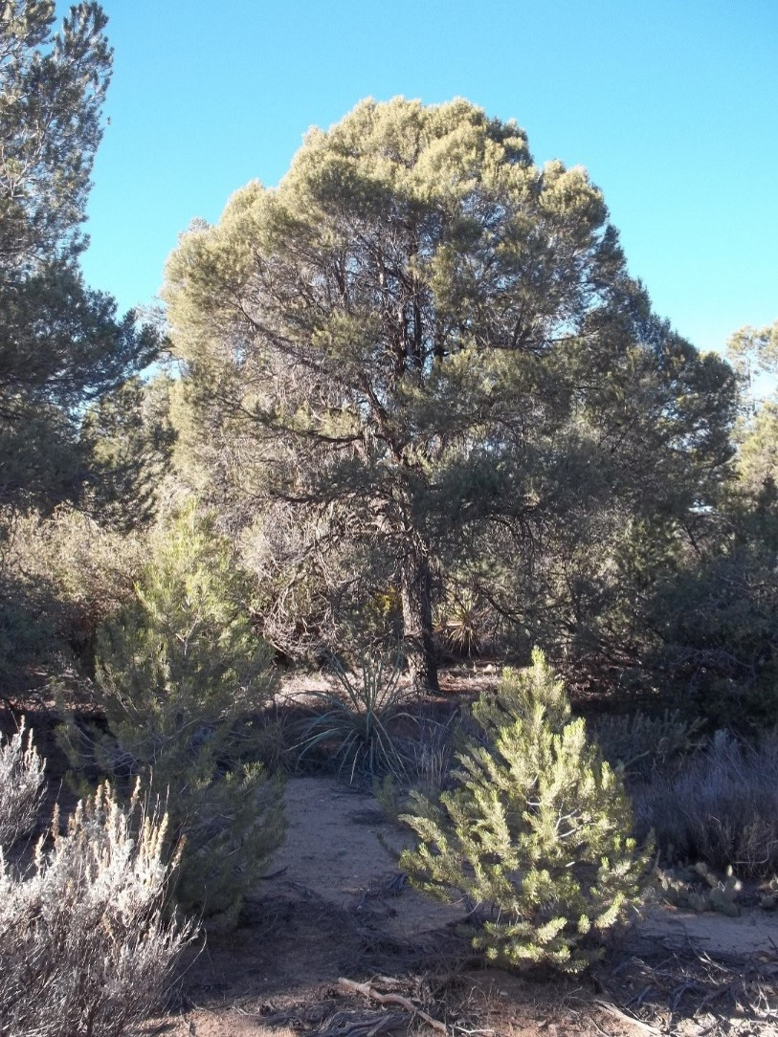
Traditional cultural practices in California
Notes:
Traditional cultural practices in California. Images provided by Pedro Torres, NRCS National Tribal Liaison

Slide 17
Forest Farming and Cultural Burning
“[Cultural burning] links back to the tribal philosophy of fire as medicine. When you prescribe it, you’re getting the right dose to maintain the abundance of productivity of all ecosystem services to support the ecology in your culture”. Frank Kanawha Lake, a research ecologist with the USDA Forest Service, and a wildland firefighter of Karuk descent – Roos, 2020
Notes:
Indigenous people used fire widely across the U.S. for a variety of purposes, many associated with forest farming activities.
Native American Used Fire to Protect and Cultivate Land. David Roos, Sept 18, 2020. History

Slide 18
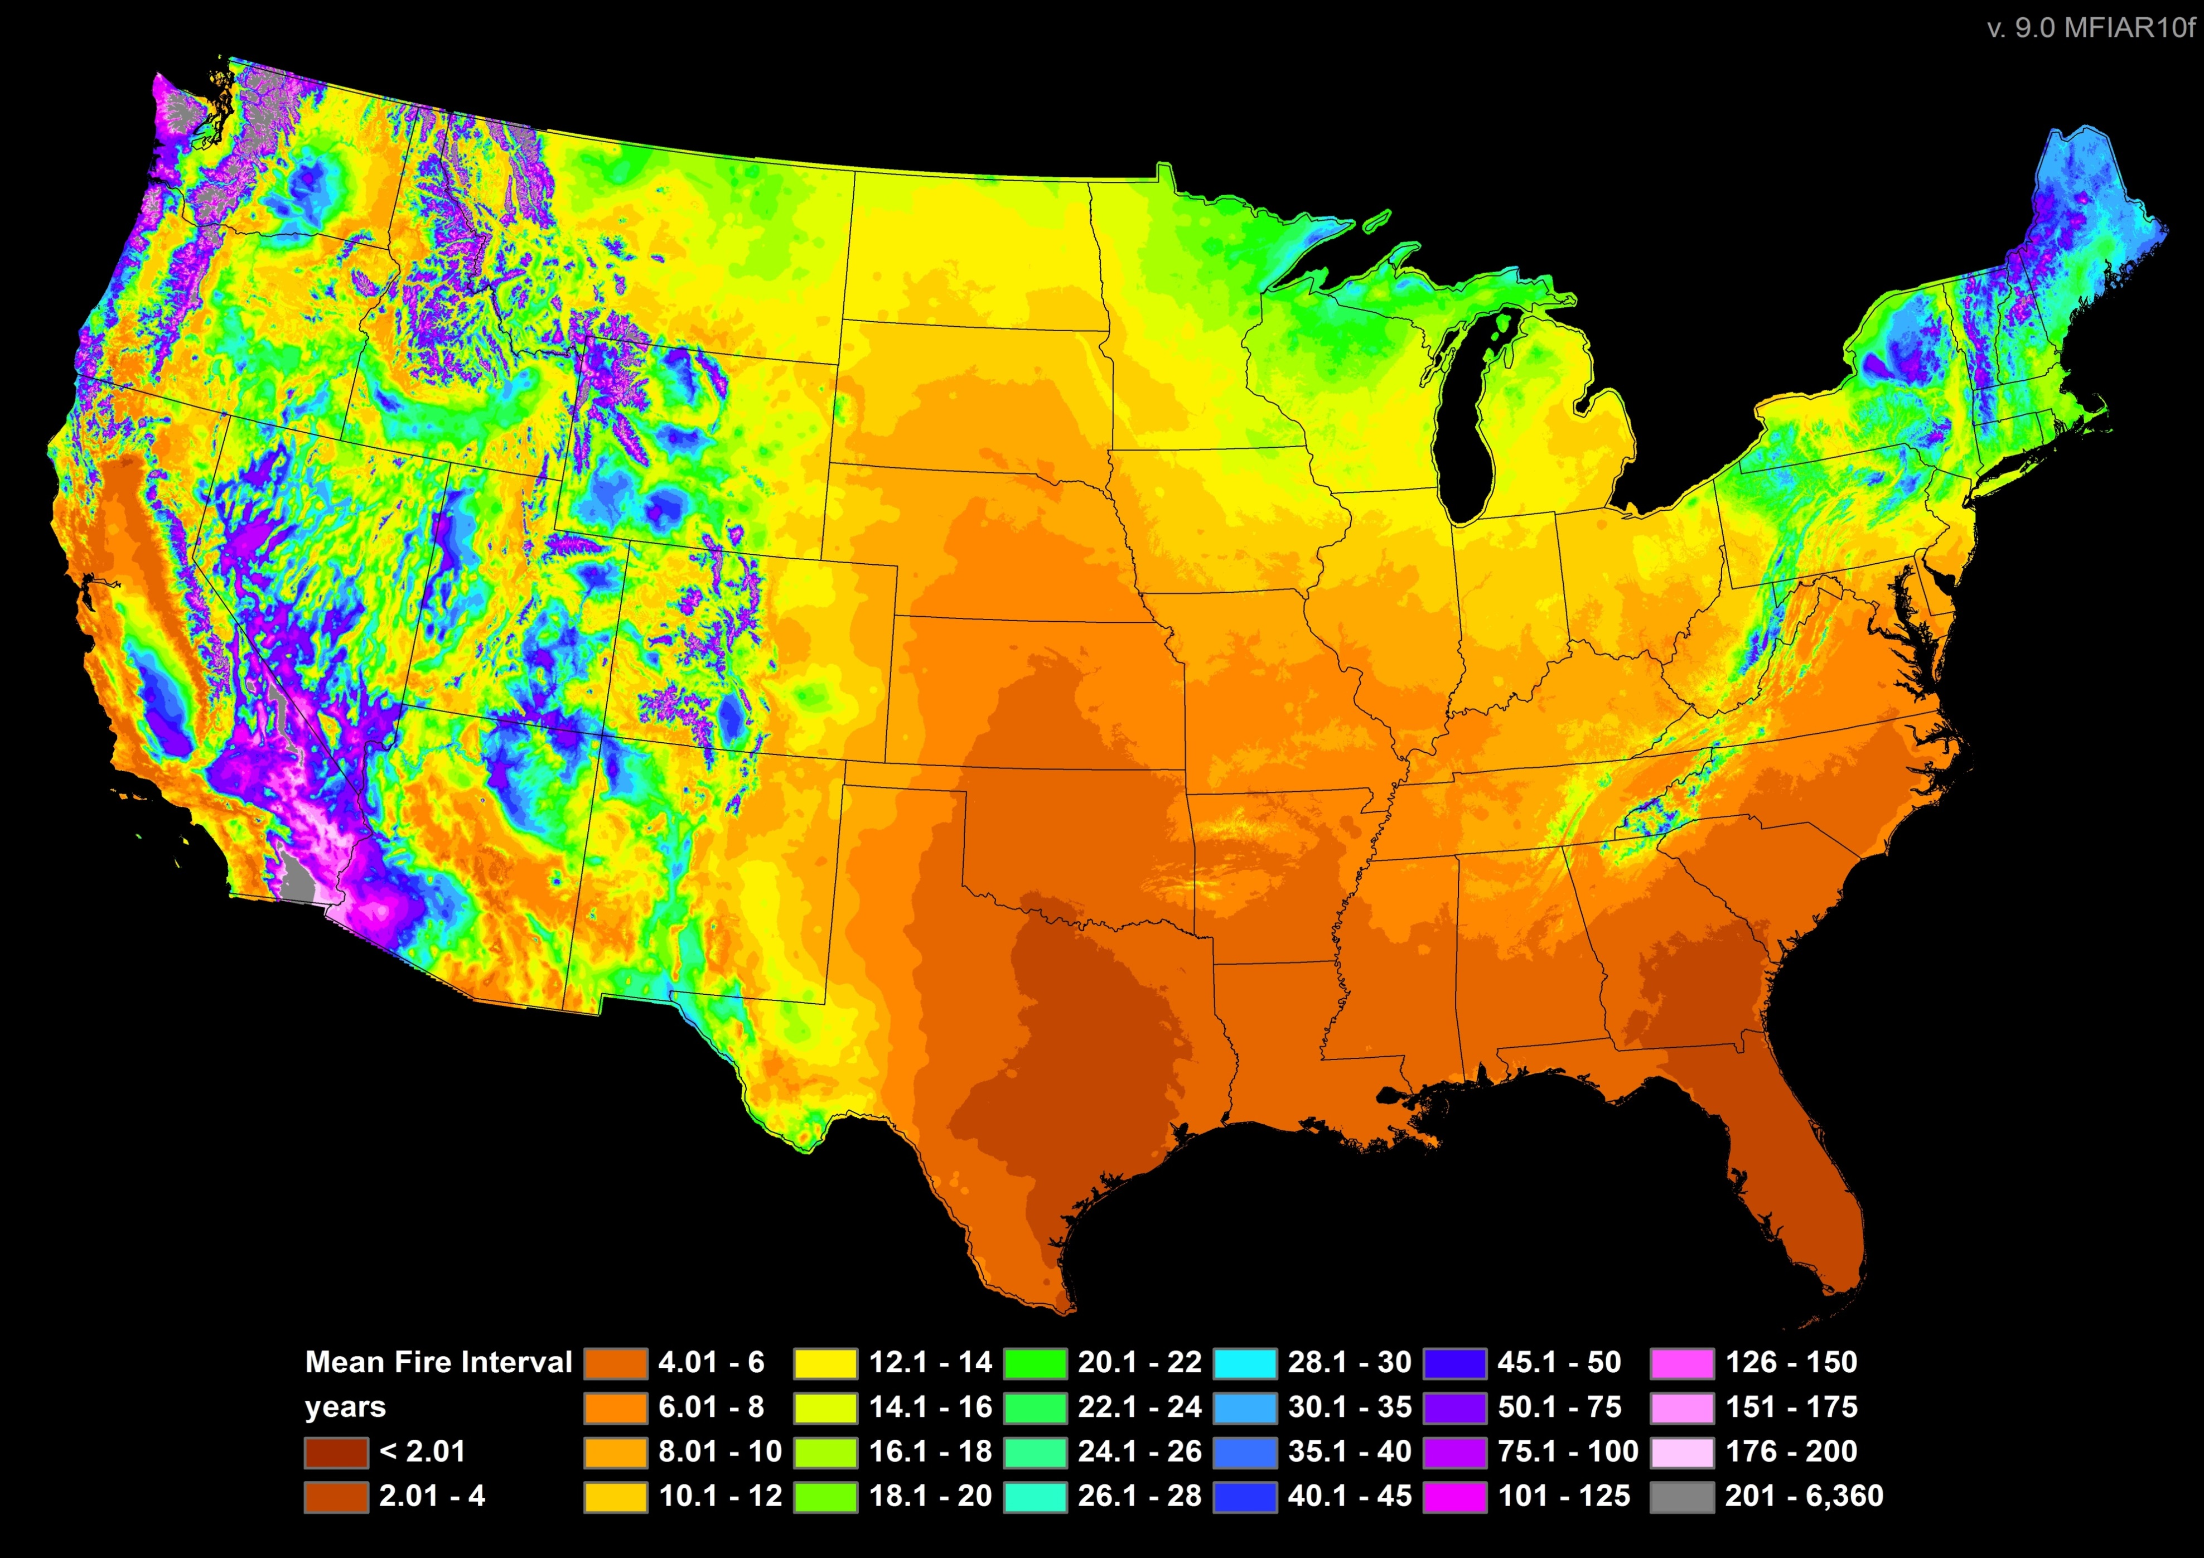
Connecting Historic Cultural Burning and Eastern Forest Structure and Composition
“Many early colonists of southern New England describe open, parklike forests because of Native American burning and vegetation management (Bromley 1935).”
“…the fire-scar record indicates that drought-induced fires are not fully realized without broad-scale human ignitions (Guyette et al. 2006).”
“The low occurrence of lightning across the East is inconsistent with the existence of vast fire-based vegetation formations and suggests that Native American ignitions were highly important (Abrams and Nowacki 2008, 2015).”
Notes:
BROMLEY, S. W. 1935. The original forest types of southern New England. Ecological Monographs 5: 61–89.
GUYETTE, R. P., M. C. STAMBAUGH, R. M. MUZIKA, AND D. C. DEY. 2006. Fire scars reveal variability and dynamics of eastern fire regimes. pp. 20–39. In M.
B. Dickinson, ed. Proceedings, Fire in Eastern Oak Forests: Delivering Science to Land Managers; November 15–17, 2005, Columbus, OH. General
Technical Report NRS-P-1. United States Department of Agriculture, Forest Service, Northern Research Station, Newtown Square, PA.
ABRAMS, M. D. AND G. J. NOWACKI. 2008. Native Americans as active and passive promoters of mast and fruit trees in the eastern USA. The Holocene 18:
1123–1137.
ABRAMS, M. D. AND G. J. NOWACKI. 2015. Exploring the Early Anthropocene burning hypothesis and climate fire anomalies for the eastern U.S. Journal of Sustainable Forestry 34: 30–48
Map from Physical Chemistry Fire Frequency Model (PC2FM). R.P. Guyette, M.C. Stambaugh, D.C. Dey, R.Mo. Muzika. 2012. Estimating fire frequency with chemistry of climate. Ecosystems. 15:322-335. The Physical Chemistry Fire Frequency Model (PC2FM) uses climate variables (temperature, precipitation, and oxygen) to estimate mean fire intervals (MFI) based on the fundamental principles of physical chemistry, particularly Arrhenius' equation, to understand and predict fire frequency.

Slide 19
Connecting Historic Cultural Burning and Eastern Forest Structure and Composition
Notes:
“Many early colonists of southern New England describe open, parklike forests because of Native American burning and vegetation management (Bromley 1935).”
“…the fire-scar record indicates that drought-induced fires are not fully realized without broad-scale human ignitions (Guyette et al. 2006).”
“The low occurrence of lightning across the East is inconsistent with the existence of vast fire-based vegetation formations and suggests that Native American ignitions were highly important (Abrams and Nowacki 2008, 2015).”
BROMLEY, S. W. 1935. The original forest types of southern New England. Ecological Monographs 5: 61–89.
GUYETTE, R. P., M. C. STAMBAUGH, R. M. MUZIKA, AND D. C. DEY. 2006. Fire scars reveal variability and dynamics of eastern fire regimes. pp. 20–39. In M.
B. Dickinson, ed. Proceedings, Fire in Eastern Oak Forests: Delivering Science to Land Managers; November 15–17, 2005, Columbus, OH. General
Technical Report NRS-P-1. United States Department of Agriculture, Forest Service, Northern Research Station, Newtown Square, PA.
ABRAMS, M. D. AND G. J. NOWACKI. 2008. Native Americans as active and passive promoters of mast and fruit trees in the eastern USA. The Holocene 18:
1123–1137.
ABRAMS, M. D. AND G. J. NOWACKI. 2015. Exploring the Early Anthropocene burning hypothesis and climate fire anomalies for the eastern U.S. Journal of Sustainable Forestry 34: 30–48
Map from Physical Chemistry Fire Frequency Model (PC2FM). R.P. Guyette, M.C. Stambaugh, D.C. Dey, R.Mo. Muzika. 2012. Estimating fire frequency with chemistry of climate. Ecosystems. 15:322-335.

Slide 20
“The trees grow wild in the fields without being planted or manured and are as large and as vigorous as if they were cultivated and irrigated in gardens.”
“In the open fields were many plums, both those of Spain and those of the land, and grapes along the rivers on vines climbing up into the trees.”
“That land was very pleasing and fertile, and had excellent fields along the rivers, the forest being clear and having many walnuts and mulberries.
  (Clayton et al., 1993)
“…archaeologists and ecologists have found evidence for wide-ranging management of forests that may explain the observed phenomenon of relatively higher proportions of nut trees of the Carya, Juglans, and Quercus genera in the vicinity of settlements”. “…permanent agricultural fields were likely established via girdling of unwanted trees and maintained with low-intensity burning, only fallowed for short periods (Abrams and Nowacki 2008).”
Notes:
Clayton LA, Knight VJ, Moore EC (1993) The De Soto chronicles: the expedition of Hernando de Soto to North America in 1539-1543. Tuscaloosa: University of Alabama Press
Abrams MD, Nowacki GJ (2008) Native Americans as active and passive promoters of mast and fruit trees in the eastern USA. The Holocene 18:1123–1137

Slide 21
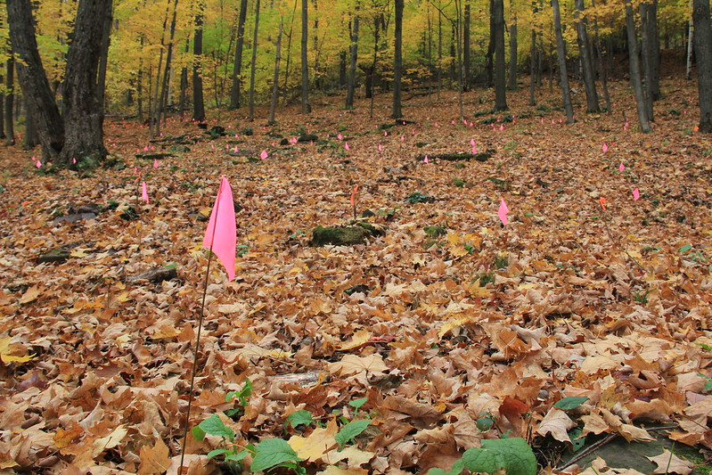
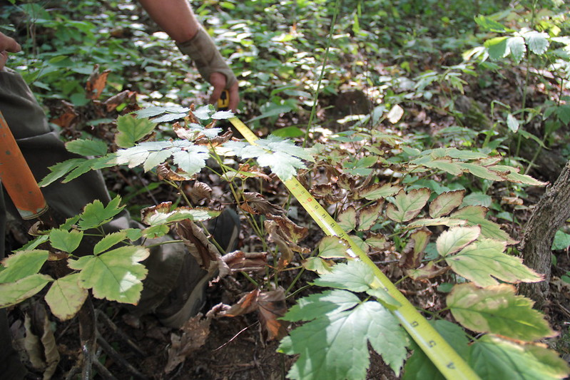
Wild Stewarding and Wild Simulated
Notes:
Following are a few images of forest farming projects. If we consider indicators of forest soil health, these seem like good examples of good soil health.
These images show “wild stewarding” of naturally occurring woodland botanicals.
The lower image shows the production of ramps under a forest canopy (National Agroforestry Center)
The upper image is black cohosh, with distance being measured between plants, part of selecting for harvest vs leave. (Forest Farming Community of Practice Flickr Album)

Slide 22
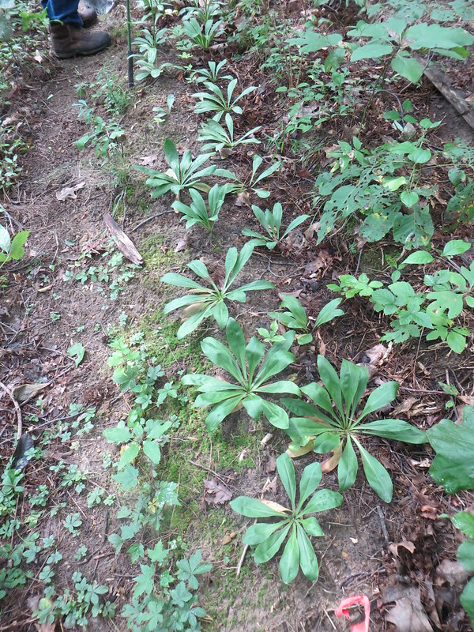
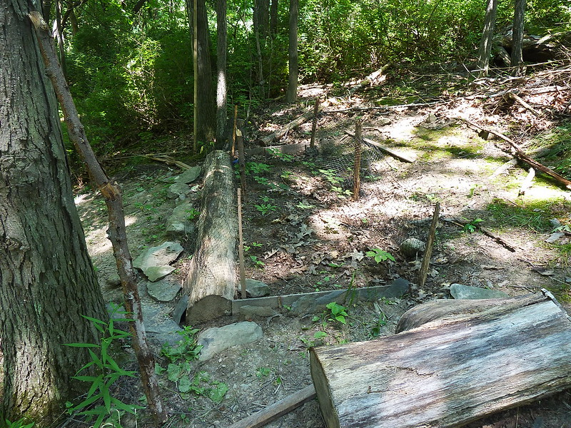
Woods Grown
Notes:
From Forest Farming Community of Practice flickr page

Slide 23
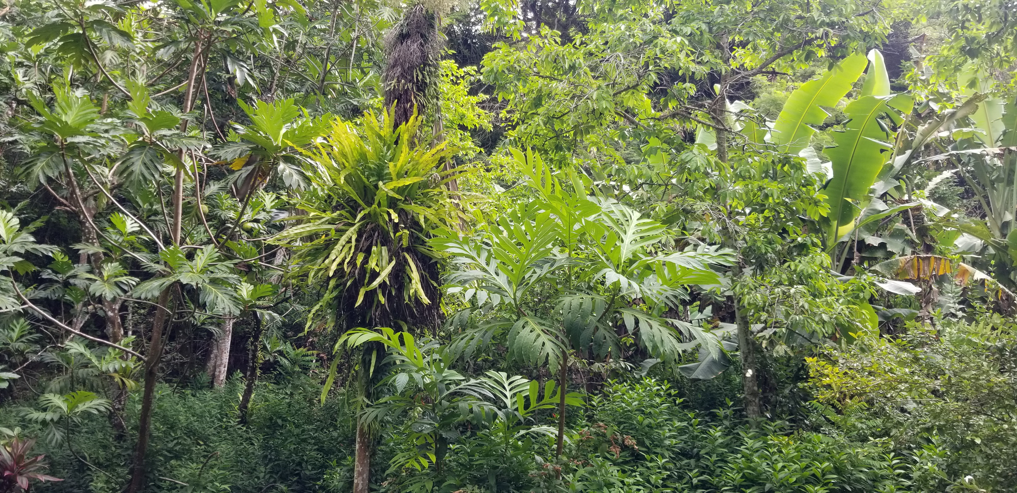
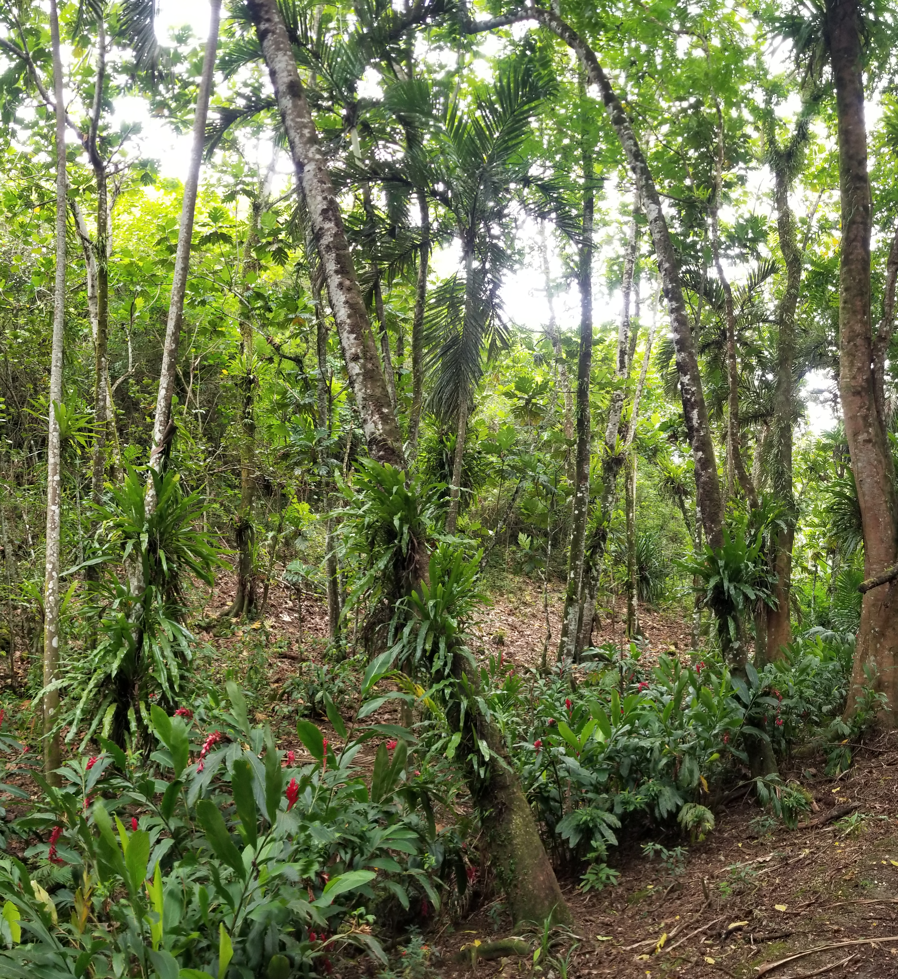
Forest Farming/Multi-story Cropping – Pacific Islands
Notes:
Forest Farming examples from PIA. Photos, Mathew Cocking
Forest farming in the tropics often consist of true multi-layered systems with a diverse mix of species suited to varying niches. Note the exposed soil in the image in the lower right.

Slide 24
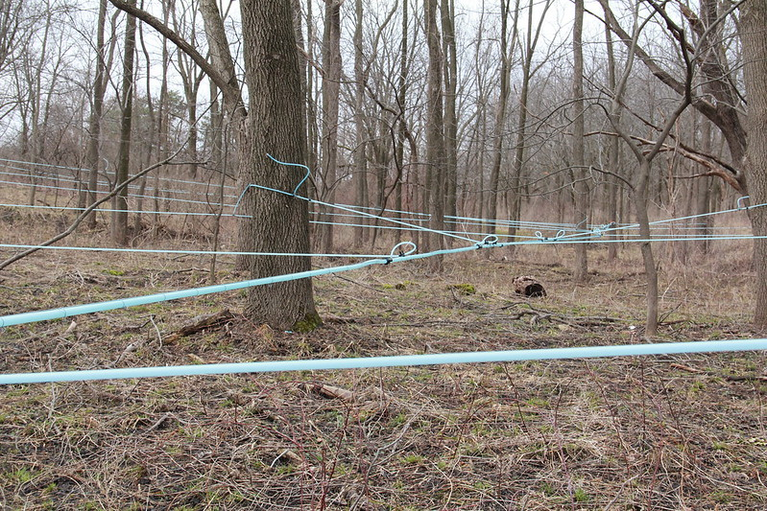
Forest Farming – Sap Collection
Notes:
Images from Forest Farming Community of Practice – Flickr Album

Slide 25
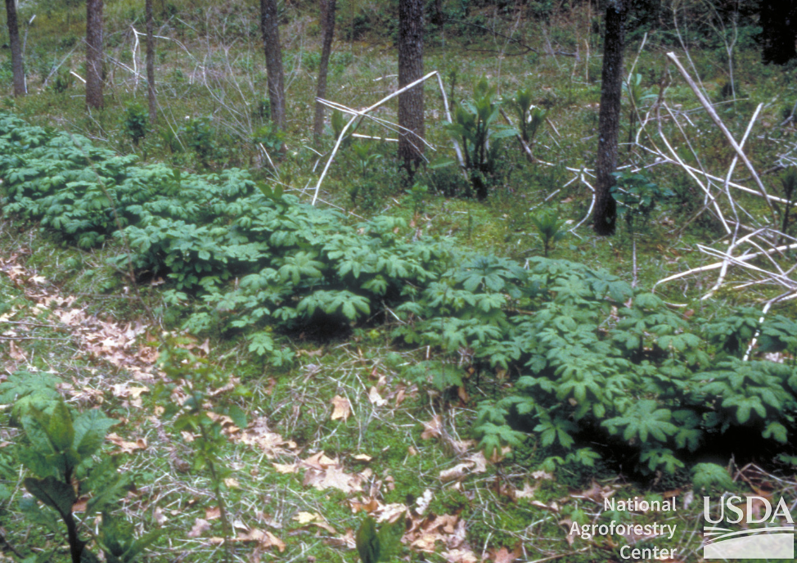
Forest Soil Health in Forest Farming Systems
Notes:
What do we know about soil health and forest farming? Not a lot, specifically, not a lot of research in this area. But because we are working in forest systems, it follows to say that farming practices should strive to meet forest soil health parameters.

Slide 26
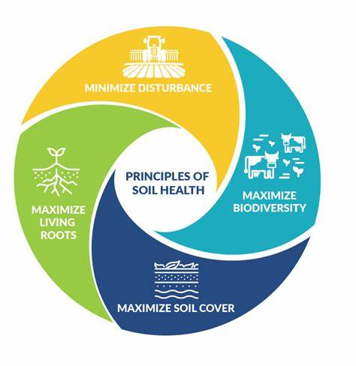
Forest Soil Health
Soil Cover
Minimal Disturbance
Living Roots
Biodiversity
Notes:
Image source: https://kaiserscience.wordpress.com/earth-science/surface-processes/soil-profile/
Forest farming can improve soil health by increasing soil cover, minimizing disturbance, increasing the presence of living roots and increasing the amount of biodiversity compared to traditional cropping system.
To briefly review, our FSH assessment tool keys in on soil cover, soil disturbance, soil structure/compaction, and living roots. An additional piece to consider is overall forest ecosystem health. Forest farming systems that are part of a healthy forest ecosystem probably exhibit good forest soil health, based on site limitations. Forest farming systems that introduce new plants or that alter the site conditions extensively are likely moving away from healthy forest soils.
The introduction of livestock into an existing forest system can have negative effects on forest soils and forest ecosystems. Let

Slide 27









Forest Soil Health
Soil Cover
Minimal Disturbance
Living Roots
Biodiversity
Forest Ecosystem Health
Notes:
Image source: https://kaiserscience.wordpress.com/earth-science/surface-processes/soil-profile/
To briefly review, our FSH assessment tool keys in on soil cover, soil disturbance, soil structure/compaction, and living roots. An additional piece to consider is overall forest ecosystem health. Forest farming systems that are part of a healthy forest ecosystem probably exhibit good forest soil health, based on site limitations. Forest farming systems that introduce new plants or that alter the site conditions extensively are likely moving away from healthy forest soils.
The introduction of livestock into an existing forest system can have negative effects on forest soils and forest ecosystems. Let

Slide 28
Forest Farming – Purposes (379 CPS)
Increase plant/tree community diversity—including native species—as well as their compatibility with each other and the site.
Improve crop diversity by growing mixed but compatible crops having different heights on the same area.
Improve soil health by maintaining or increasing soil organic matter.
Improve terrestrial habitat.
Notes:
We identify four purposes for forest farming. Obviously the third purpose makes a direct connection between forest farming activities and soil health. But lets consider the other three also.
In most cases, the first two purposes will be tied to Plant resource concerns. From a soil health perspective, plant structure and composition would be the more common resource concern component. That is, we can generally assume that improving structure and composition above ground will improve structure and composition below ground in terms of root exploration and interactions. Productivity and health may be applicable when managing to improve conditions for a targeted forest crop such as ginseng or a maple tree.
Terrestrial habitat is linked to forest soil health. However, the links are not as obvious because these are usually complex ecological connections and thus this is not an RC that we would typically connect to forest soil health in association with forest farming.
As with alley cropping, this practice may definitely be planned to address habitat. But again it is important to make sure that the tree/shrub spp will actually provide the habitat needs for the target wildfire or pollinator spp.
Note that carbon sequestration and storage is not included here, but it is included later in the standard under considerations.

Slide 29
Forest Farming – Soil Health
Beneficial to microbial habitat
  Diversity in plant growth and root architecture.
  Diversity of root exudates.
  Improved aggregation (compared to cropland).
Decrease Compaction
  Diverse root architecture can mitigate soil compaction.
Notes:
As previously mentioned, forest farming can address the four principles of soil health.
While these resource concern are not listed as NRCS purposes, forest farming can decrease compaction and has direct benefits to the microbial habitat.
Ask the class how forest farming could be beneficial to microbial habitat and decrease compaction.
Ask the class if it is possible for forest farming to have a negative effect.

Slide 30
Forest Soil Health
Soil Cover
Minimal Disturbance
Living Roots
Biodiversity
Forest Ecosystem Health
Notes:
Image source: https://kaiserscience.wordpress.com/earth-science/surface-processes/soil-profile/
It is important to consider what the current management of the land to ensure that implementing forest farming will increase soil cover, maximize diversity, minimize disturbance, and increase the presence of living roots to ensure that the purposes of the practice are met. While forest farming can have a positive impact on soil health, it may not have a positive impact if the land is currently managed as healthy, undisturbed forest.
To briefly review, our FSH assessment tool keys in on soil cover, soil disturbance, soil structure/compaction, and living roots. An additional piece to consider is overall forest ecosystem health. Forest farming systems that are part of a healthy forest ecosystem probably exhibit good forest soil health, based on site limitations. Forest farming systems that introduce new plants or that alter the site conditions extensively are likely moving away from healthy forest soils.
The introduction of livestock into an existing forest system can have negative effects on forest soils and forest ecosystems. Let

Slide 31
Forest Soil Health
Soil Cover???
Minimal Disturbance???
Living Roots?
Biodiversity?
Forest Ecosystem Health???
Notes:
Image source: https://kaiserscience.wordpress.com/earth-science/surface-processes/soil-profile/
To briefly review, our FSH assessment tool keys in on soil cover, soil disturbance, soil structure/compaction, and living roots. An additional piece to consider is overall forest ecosystem health. Forest farming systems that are part of a healthy forest ecosystem probably exhibit good forest soil health, based on site limitations. Forest farming systems that introduce new plants or that alter the site conditions extensively are likely moving away from healthy forest soils.
The introduction of livestock into an existing forest system can have negative effects on forest soils and forest ecosystems.

Slide 32
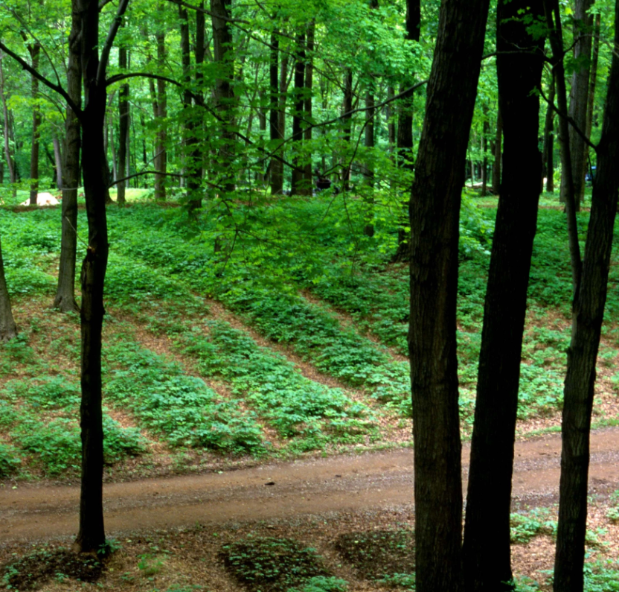
Continuum of Intensity and Disturbance

Slide 33
Notes:
From Forest Farming Community of Practice flickr page

Slide 34

Notes:
From Forest Farming Community of Practice flickr page

Slide 35
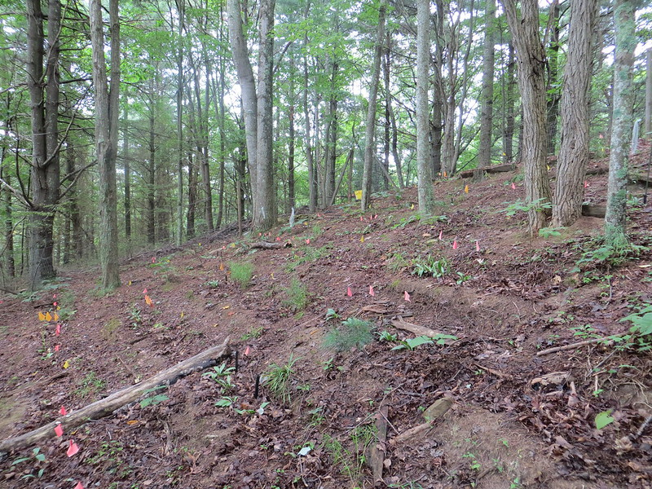
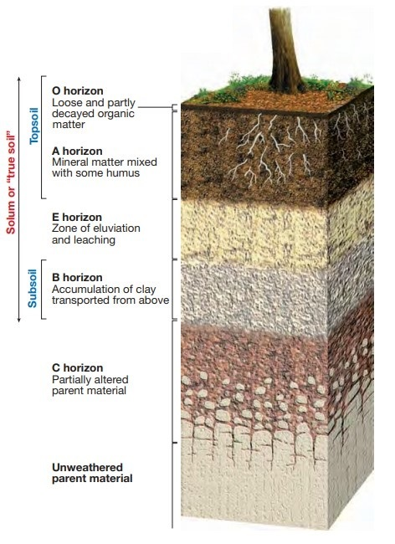
Notes:
From Forest Farming Community of Practice, Photos by Katie Trozzo
Forest Soil Profile Image source: https://kaiserscience.wordpress.com/earth-science/surface-processes/soil-profile/

Slide 37
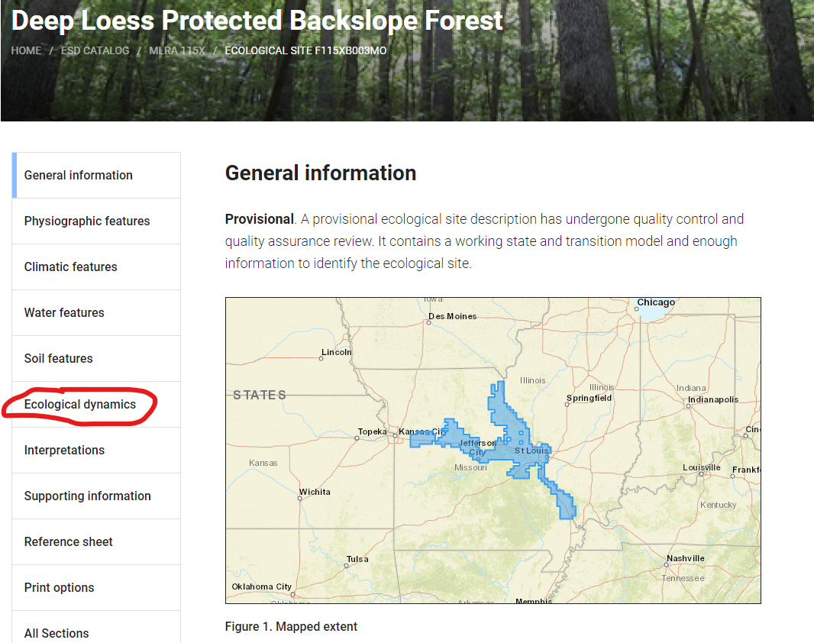


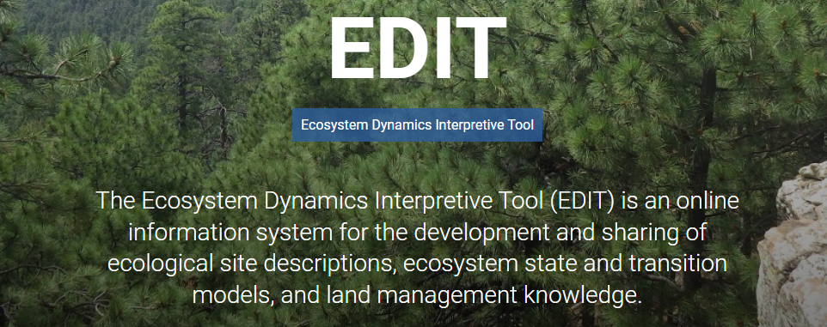
https://edit.jornada.nmsu.edu/

Slide 38
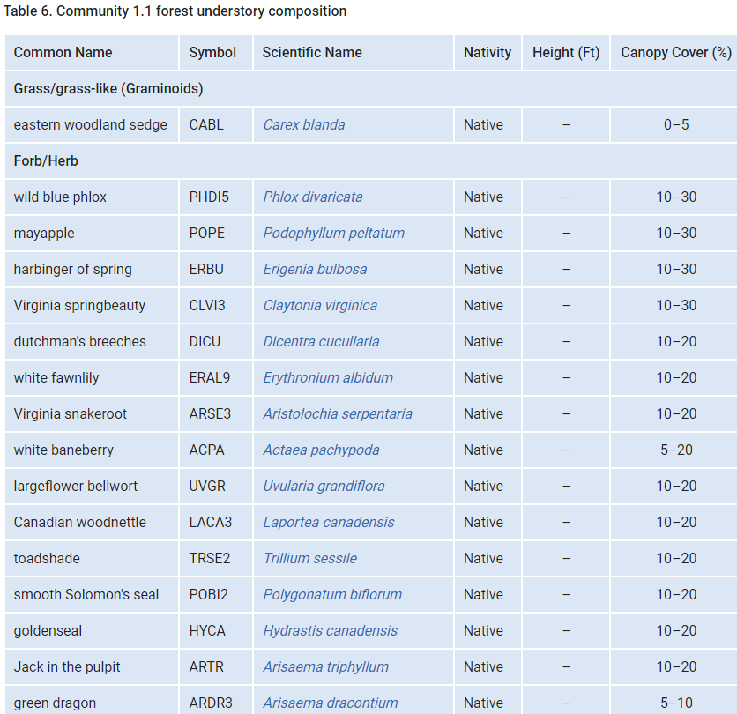
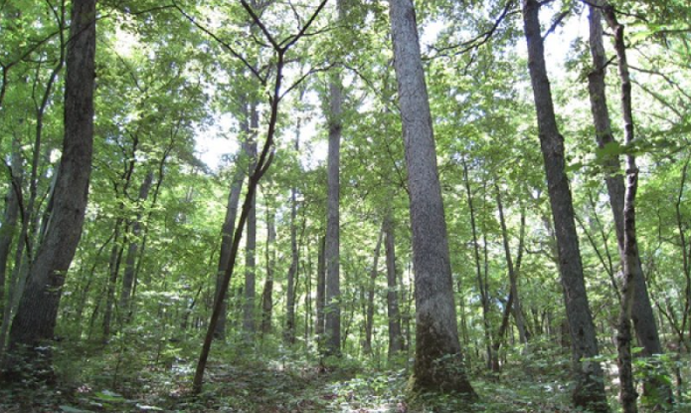

Slide 40
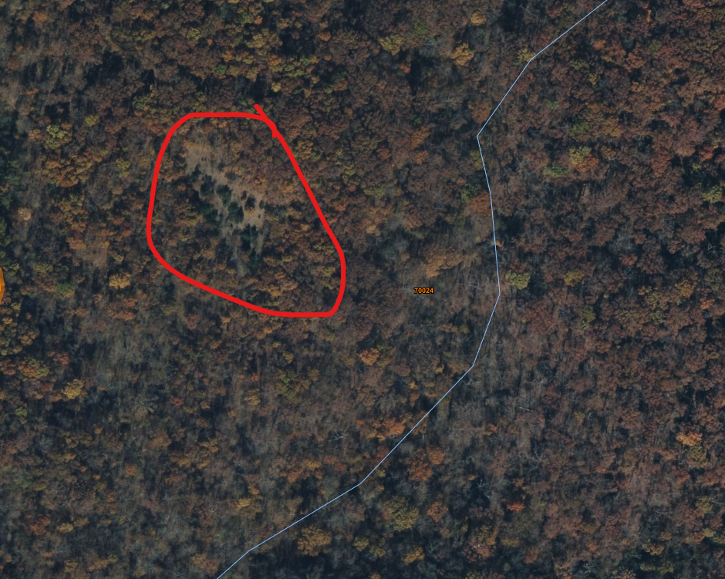
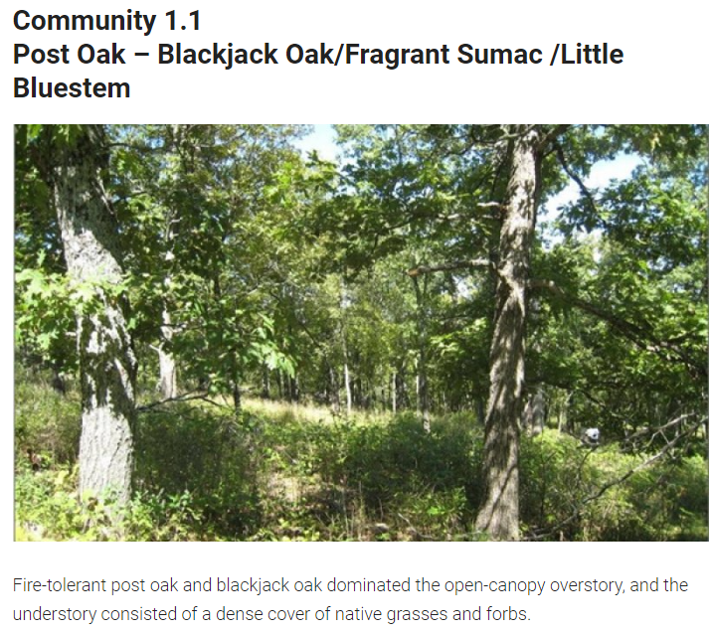
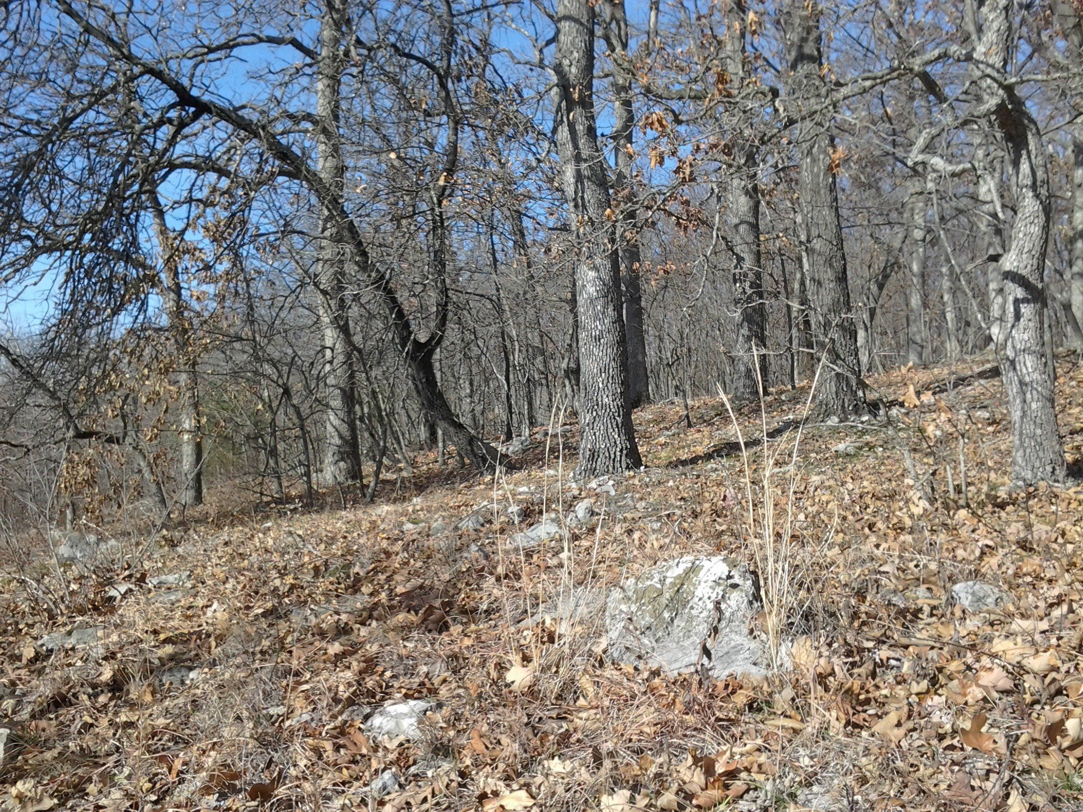

Slide 41
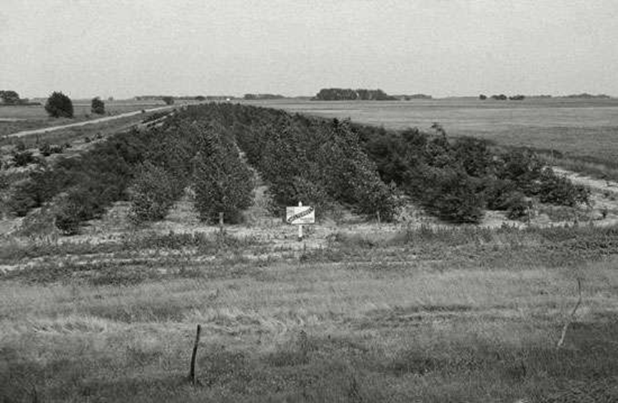
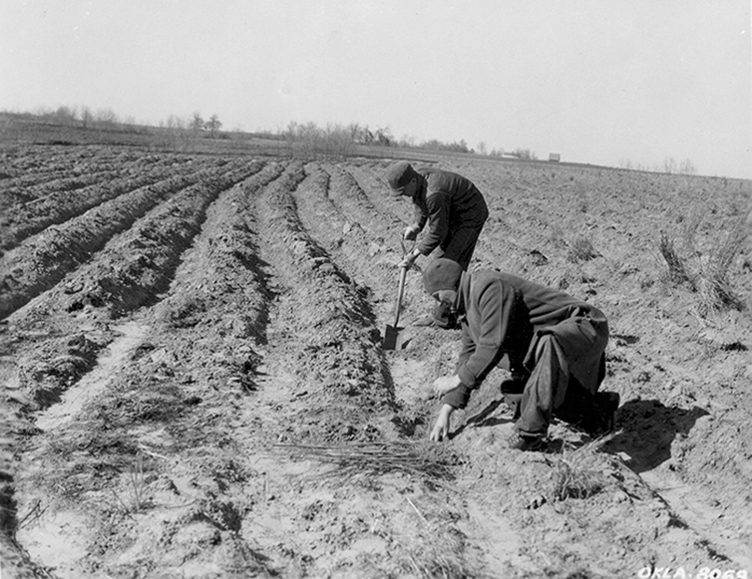
joe.alley@usda.gov

Slide 42
Thank you!
For more information on Managing Soil Health,
visit us here:
https://www.nrcs.usda.gov/conservation-basics/natural-resource-concerns/soils/soil-health
USDA is an equal opportunity provider, employer, and lender.

